Slide 1
DIVISION
SPERMATOPHYTA

Slide 2
DIVISION SPERMATOPHYTA
or
PHANEROGAMS (Flowering plants)
SPERMATOPHYTES (Seed plants)
There are two subdivisions of Spermatophytes: Gymnosperms and Angiosperms

Slide 3
SUBDIVISION GYMNOSPERMA (THE GYMNOSPERMS)
The Gymnosperms are closely related to the higher Cryptogams on the one hand and to the angiosperms on the other.
Thus they form an intermediate group between the two.

Slide 4
The lower Gymnosperms like cycads have greater affinities with the higher Cryptogams, while the higher Gymnosperms - Coniferales and Gnetales- are closer to the Angiosperms

Slide 5
The name Gymnosperm refers to the exposed nature of the seeds, which are produced on the surface of the sporophylls or similar structures instead of being enclosed within a fruit as they generally are in the flowering plants.

Slide 6
CLASS CYCADOPSIDA – The Cycads
Order Cycadales: eg. Cycas,
Encephalartos, Zamia

Slide 7
CYCAS
The stem of Cycas is unbranched, erect, stout and palm-like with a crown of pinnate leaves arranged spirally round the apex.
Small, dry, scale-like leaves alternate with the green pinnate leaves.
Vernation (Ptyxis) of the leaf is circinate like that of ferns.

Slide 8
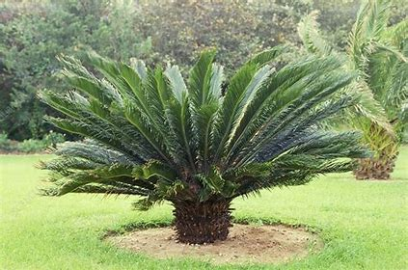

Slide 9


Slide 10
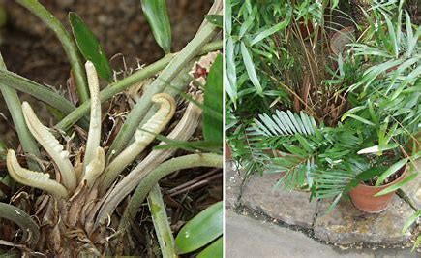

Slide 11
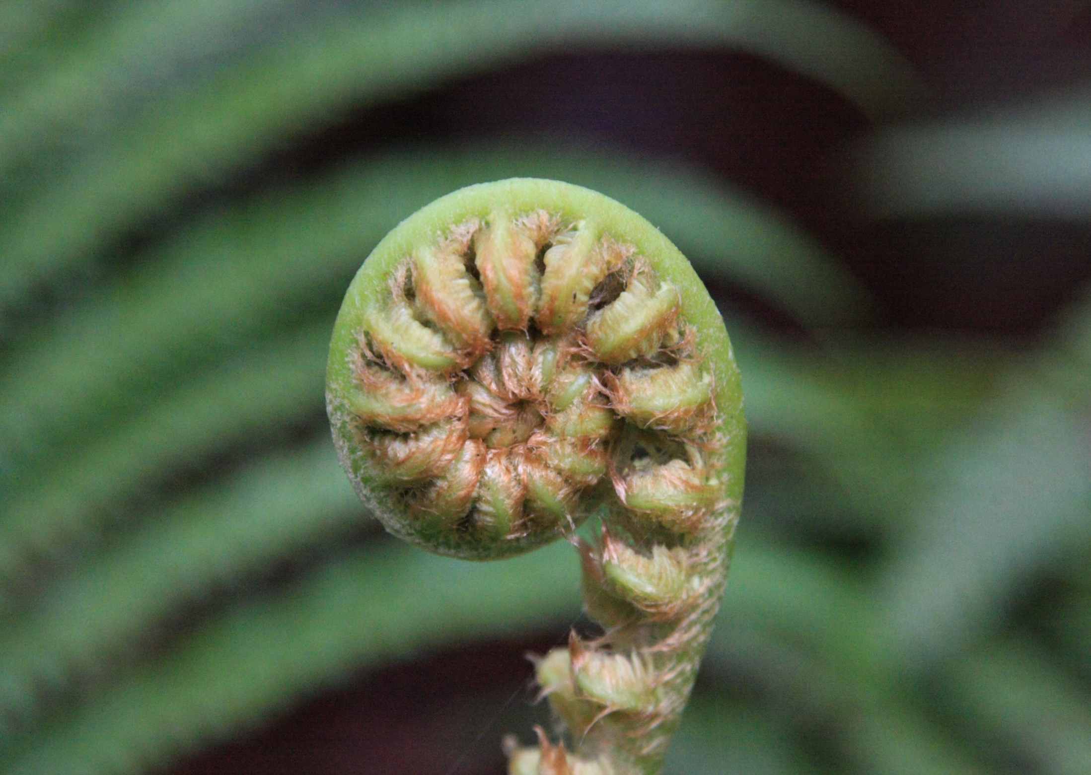

Slide 12
The plant has long primary (tap) root.
Cycads are dioecious, ie. male and female flowers are borne by separate plants.
The male flower is a cone, borne at the apex of the stem, which then grows by a lateral bud (the stem becomes a sympodium).

Slide 13
The male cone consists of a collection of stamens or microsporophylls arranged spirally round the axis.
Each sporophyll is in the form of a scale, narrowed below and broadened above.

Slide 14
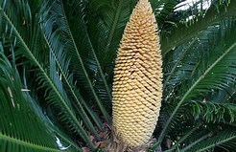

Slide 15
Its under surface bears several pollen sacs or microsporangia grouped in sori.
There are usually 2 to 6 pollen sacs in each sorus.
Each pollen sac contains many pollen grains or microspores.

Slide 16
The nucleus of each microspore divides once and produces an extremely reduced prothallus cell (male gametophyte) on one side and a large antheridial cell (not shown in diagram) on the other.
The antheridial cell divides again and produces a generative cell and a tube cell (nucleus).

Slide 17
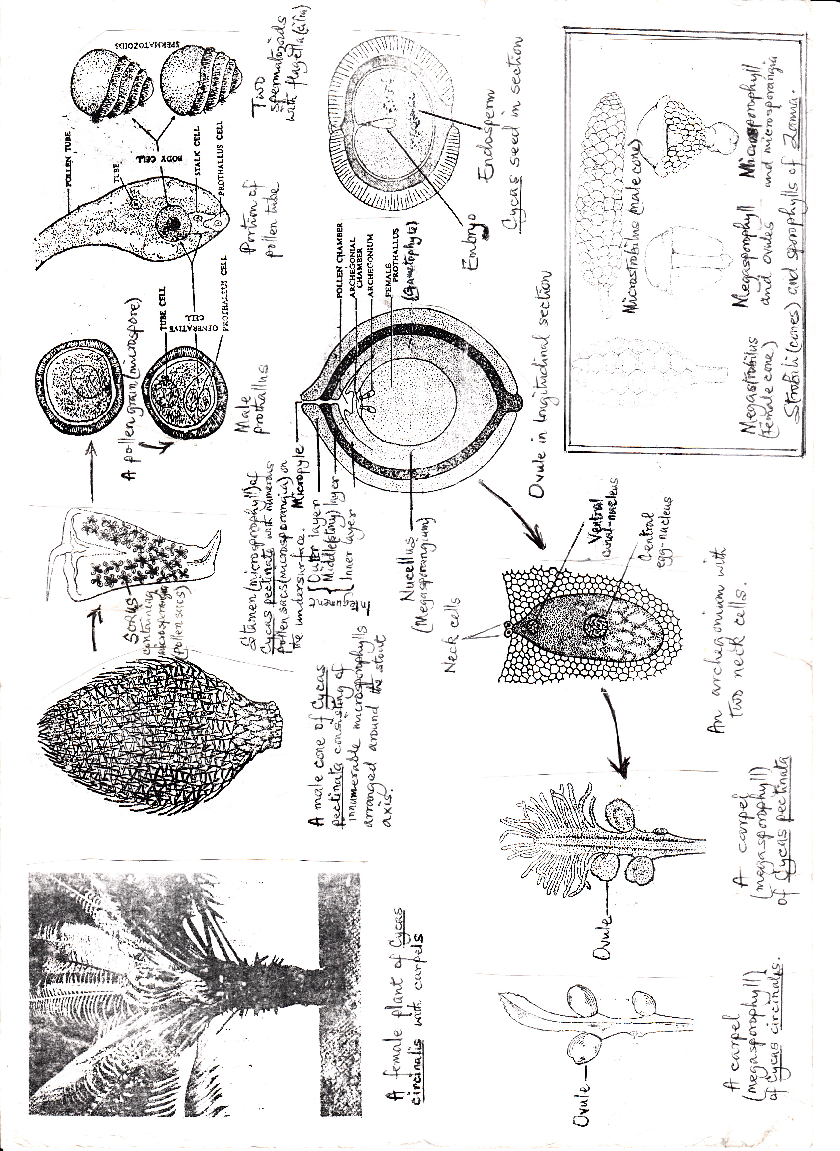

Slide 18
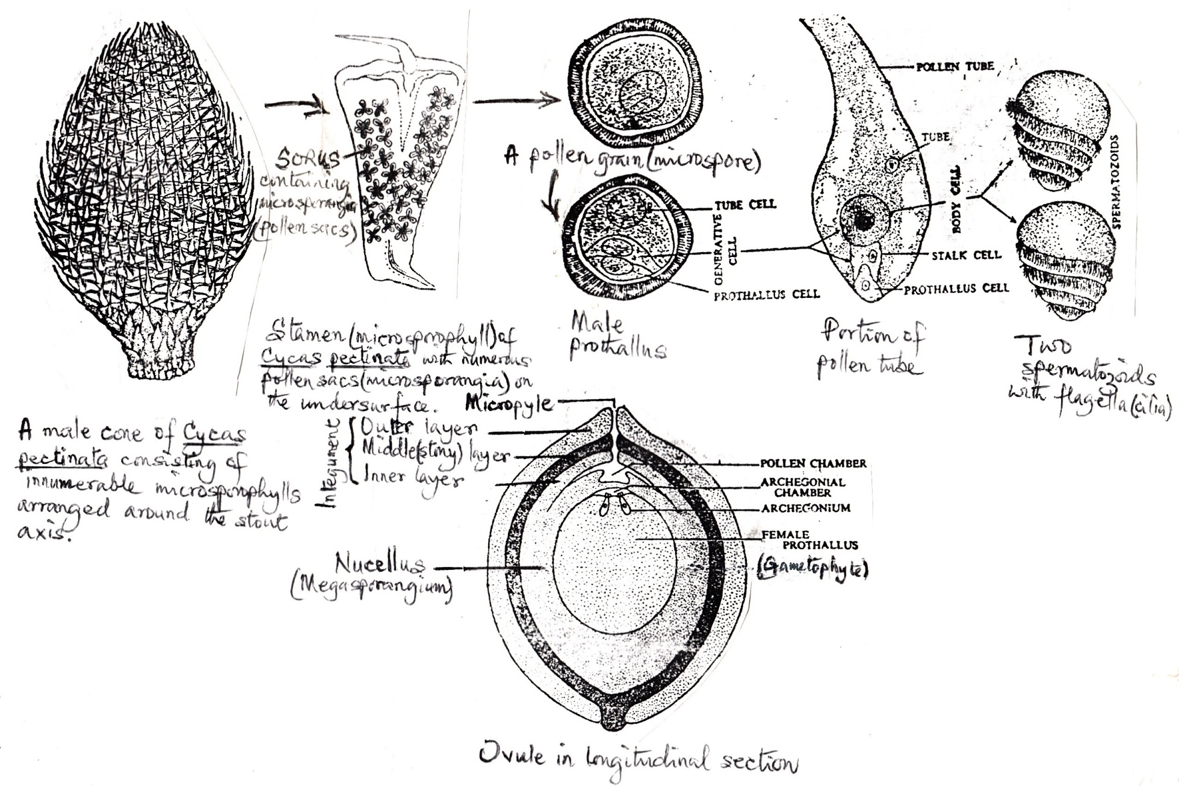

Slide 19
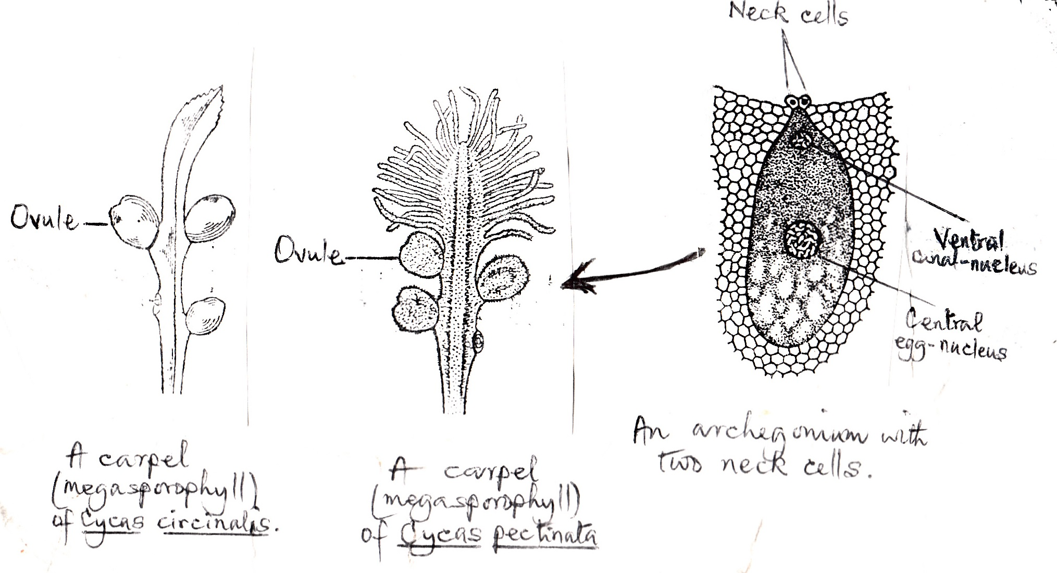

Slide 20
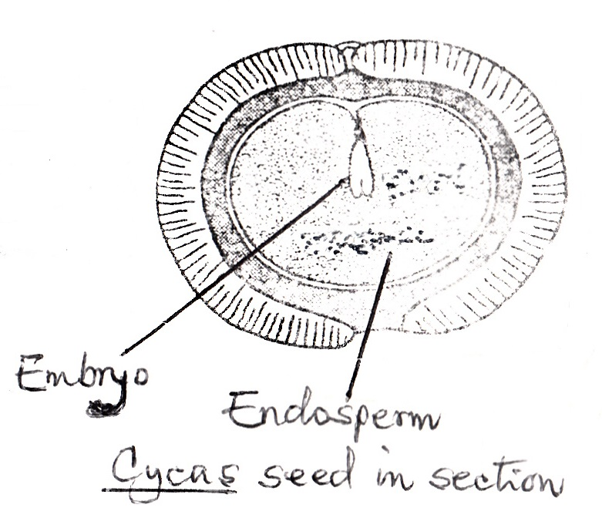

Slide 21
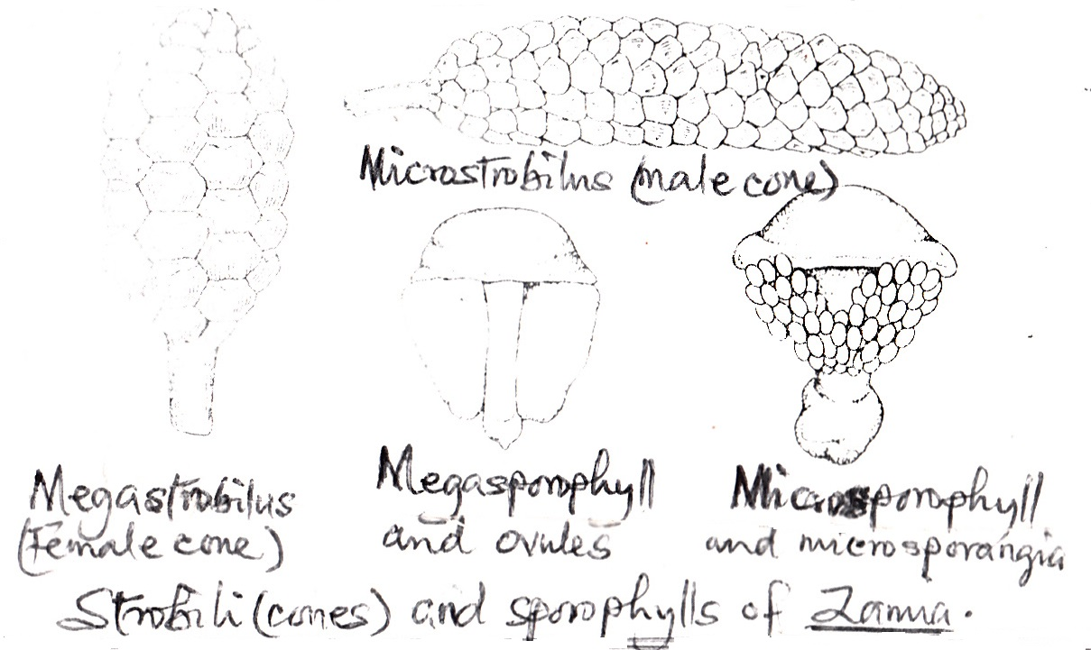

Slide 22
The pollen grain is shed at this three-celled stage and subsequent changes take place after pollination.
In Cycas, there is no proper female flower.
The plant bears near its apex a rosette of carpels or megasporophylls which do not form a cone but are arranged alternately with the leaves.

Slide 24
They are usually 15-30cm long, flattened or bent over like a hood and often dilated above.
In many species, they are covered all over with soft brownish hairs.
Usually, 2-3 pairs of ovules (sometimes up to 5 pairs) are borne in an alternate or opposite manner on notches on either side of the stalk.

Slide 25
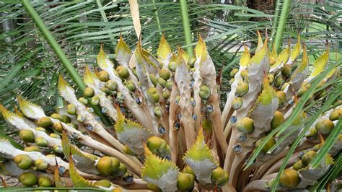

Slide 27
These are mostly oval and large.
The carpel in Gymnosperms is always open ie. it does not close up as in Angiosperms, to form the ovary, style and stigma.
Ovules are borne freely exposed on the two margins of the carpel.
The ovule grows considerably even after fertilization.

Slide 28
The ovule consists of a single thick integument and a nucellus or megasporangium, fused practically throughout with the integument.
The integument has an apical opening (the micropyle) and consists of three layers - a stony layer and a fleshy layer on either side.

Slide 29
The inner layer of the integument merges into the nucellus lower down
A megaspore mother cell is produced within the nucellus of the ovule.
This divides to form a row of 4 megaspores.

Slide 30
Only one megaspore is functional; the other three disintegrate.
The functional megaspore divides rapidly and gives rise to a cellular mass of tissue within it.

Slide 31
This is the female prothallus or female gametophyte (designated as endospers).
The prothallus is completely endosporous (ie. remains permanently enclosed within the nucellus).
The fully developed female gametophyte is cellular and large, occupying the major part of the nucellus.

Slide 32
It has two distinct regions - a region of smaller cells towards the upper end and a region of larger cells nutritive in function (endosperm).
The endosperm grows rapidly after fertilization and forms the major part of the seed.
The small-celled region produces a few (2-8) archegonia towards the micropyle.

Slide 33
Each archegonium is extremely small and consists of a very short neck with two small cells (but no neck canal cells), and a large venter completely filled by an egg-cell.
There is a distinct egg-nucleus lying somewhere in its centre.

Slide 34
Just below the micropyle, a chamber or cavity is formed due to the breaking down of some of the nucellus cells.
This cavity is called the pollen chamber.
Just below this, another chamber is formed in the prothallus.
This is the archegonial chamber.

Slide 35
POLLINATION AND FERTILIZATION
The pollen grains are carried by the wind.
They fall on the micropyle and get bathed in the mucilage secreted by the micropyle.
As the mucilage dries up, the pollen grains are drawn into the pollen chamber.
The pollen grain divides and forms:

Slide 36
a small prothallus cell (male gametophyte) on one side
a generative cell
a tube cell
The tube cell elongates into a long, branched pollen-tube which enters the archegonial chamber, the membrane between the two chambers having broken down.

Slide 38
The generative cell divides into two – the stalk cell and the body cell.
The stalk cell is sterile and the body cell divides into two male gametes (spermatozoids).
These are remarkably large, top-shaped and multiciliate.

Slide 39
The cilia are arranged in a spiral band.
The pollen tube bursts at the apex and the spermatozoids are set free.
They swim to the archegonium by vibrating their cilia and enter the egg-cell.

Slide 40
The male nucleus slips out of its cytoplasmic sheath, moves towards the egg-nucleus and finally penetrates it.
Fertilization is thus effected.
The interval between fertilization and pollination is about 4 months.

Slide 41
DEVELOPMENT OF THE EMBRYO
After fertilization the egg-nucleus undergoes nuclear divisions.
Later, cell walls are formed round the nuclei.
The cellular mass at the base of the egg constitutes the proembryo, while the upper cells form a large food reservoir.

Slide 42
The proembryo soon differentiates into a suspensor and a terminal embryo.
The embryo becomes differentiated into a radicle, a plumule and a pair of cotyledons.
Although there are a few archegonia, only one embryo matures into a seed.

Slide 43
SEED
After fertilization, the ovule as a whole grows into a seed.
The mature seed bears only one embryo differentiated into a hypocotyl, a radicle, a plumule and two cotyledons (a constant feature of all cycads).
The cotyledons remain embedded in the endosperm and absorb food from it.

Slide 45
The seed coat or integument surrounding the seed consists of a thick fleshy outer layer and a stony inner layer.
The endosperm stores a considerable quantity of food for the use of the embryo while the seed germinates.
Its germination is prompt, without any period of rest.

Slide 46
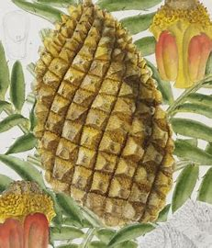

Slide 47
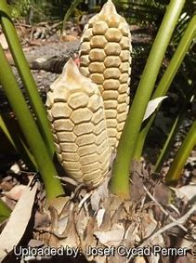

Slide 48
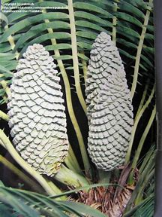

Slide 49
CLASS CONIFEROPSIDA Order Coniferales - The conifers
The conifers constitute the largest order among the Gymnosperms.
They grow mostly in cold climates and at high altitude in the hills and are evergreen trees or shrubs.

Slide 50
Some of the genera are pine (Pinus), fir (Abies), spruce (Picea), cedar (Cedrus).
Pine is a tall erect evergreen tree, often growing to a height of 45m, with a basal girth of 3m.

Slide 51
PINUS – Pine
The plant has a well developed tap root and many aerial branches with green needle-like leaves.
There are 2 kinds of branches – long (of unlimited growth) developing from lateral buds and the dwarf (of limited growth).

Slide 52
The leaves are also of two kinds – long, green needle-like leaves (usually called needles) borne only on the dwarf branches (or foliar spurs, as they are called) and small brown scaly leaves borne on both kinds of branches.
The number of needles in a cluster varies from 1 to 5.

Slide 53
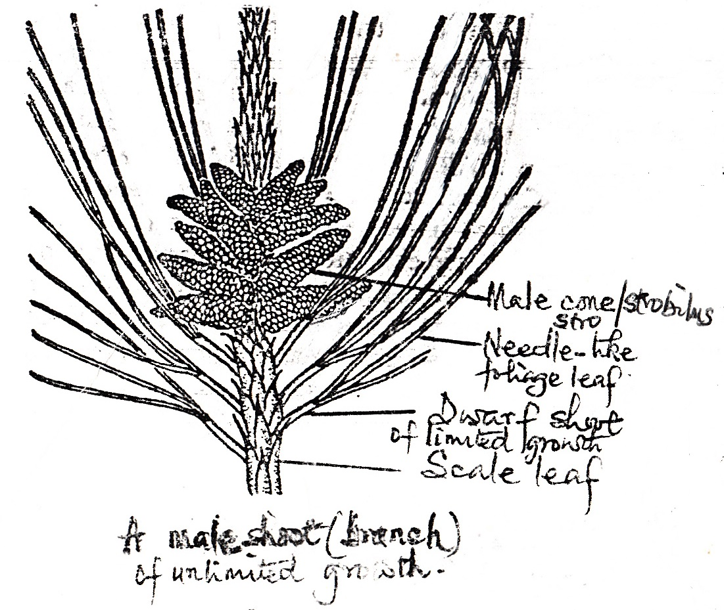

Slide 54
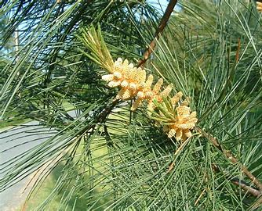

Slide 55
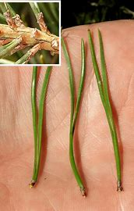

Slide 56
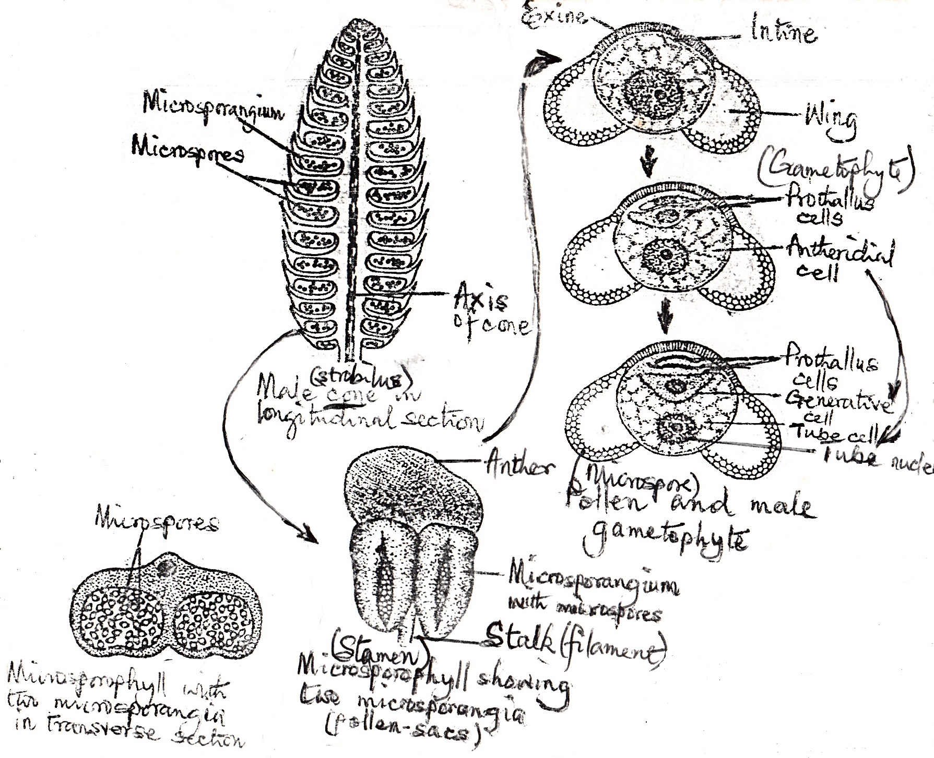

Slide 57
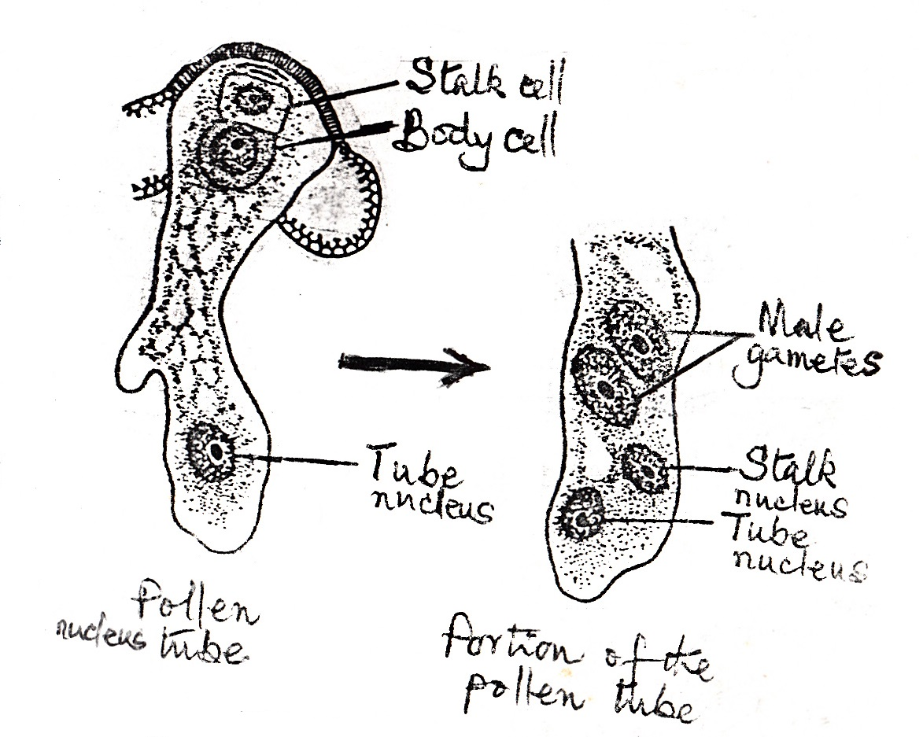

Slide 58
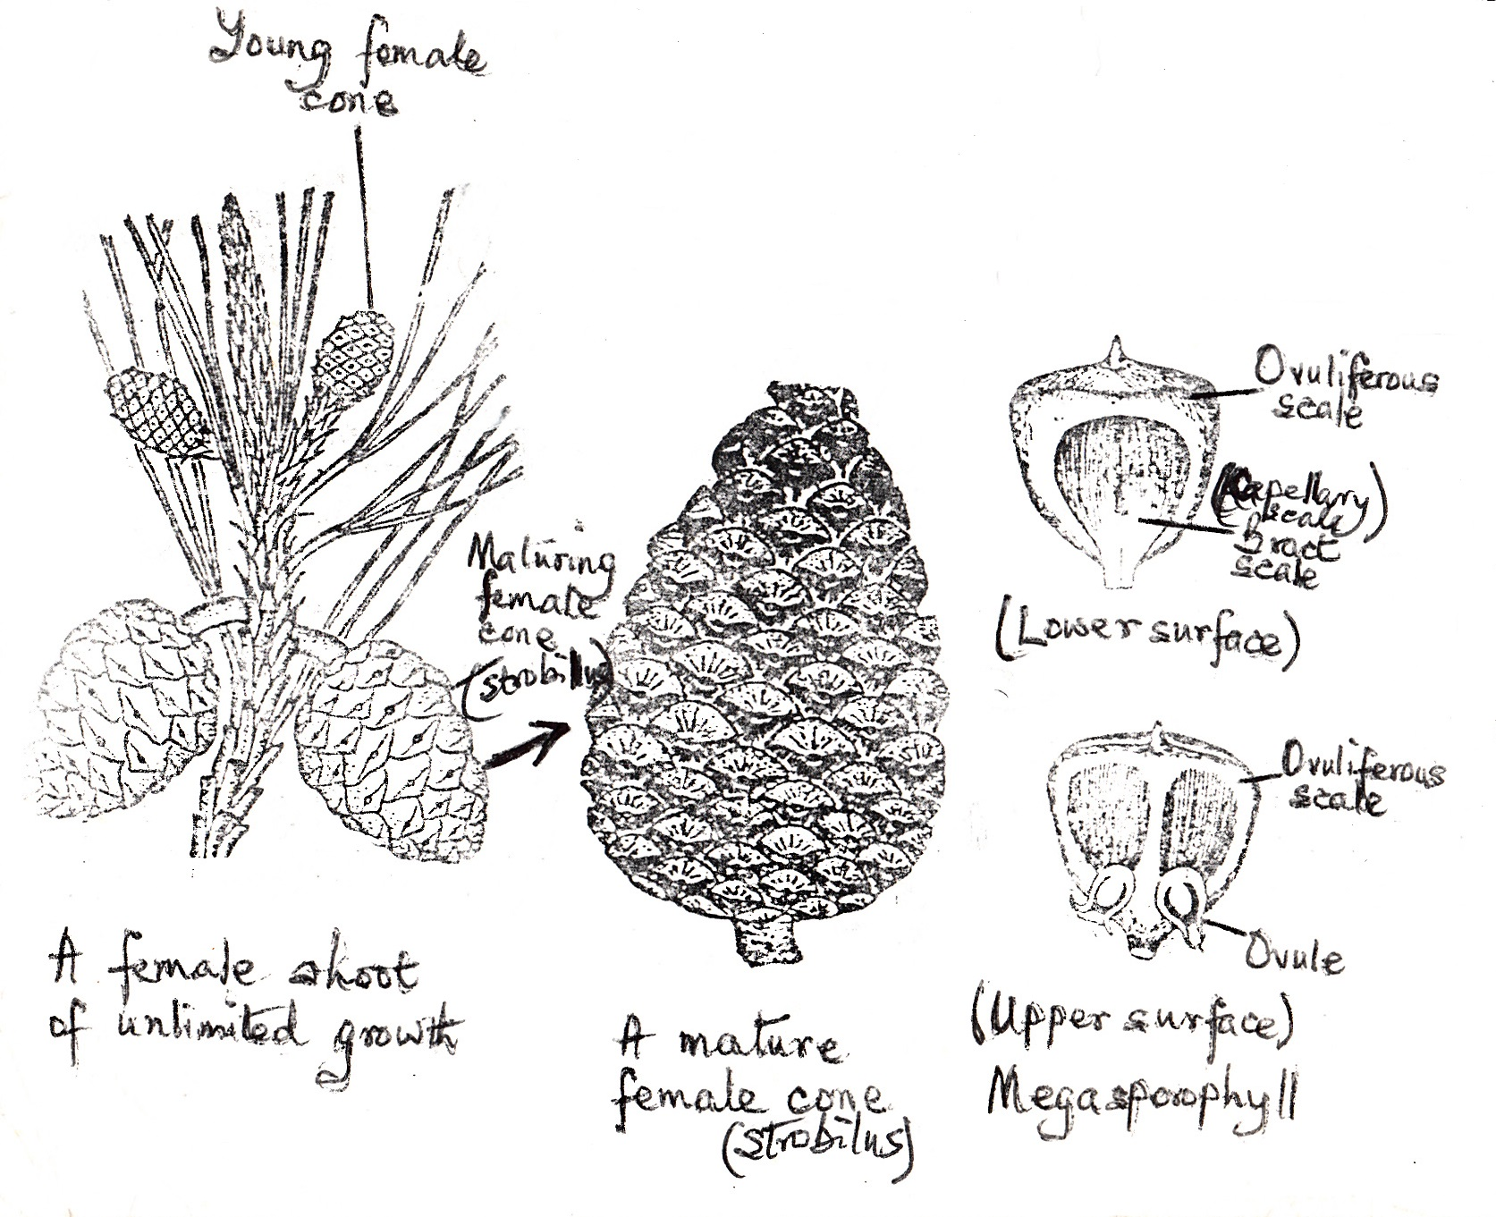

Slide 59
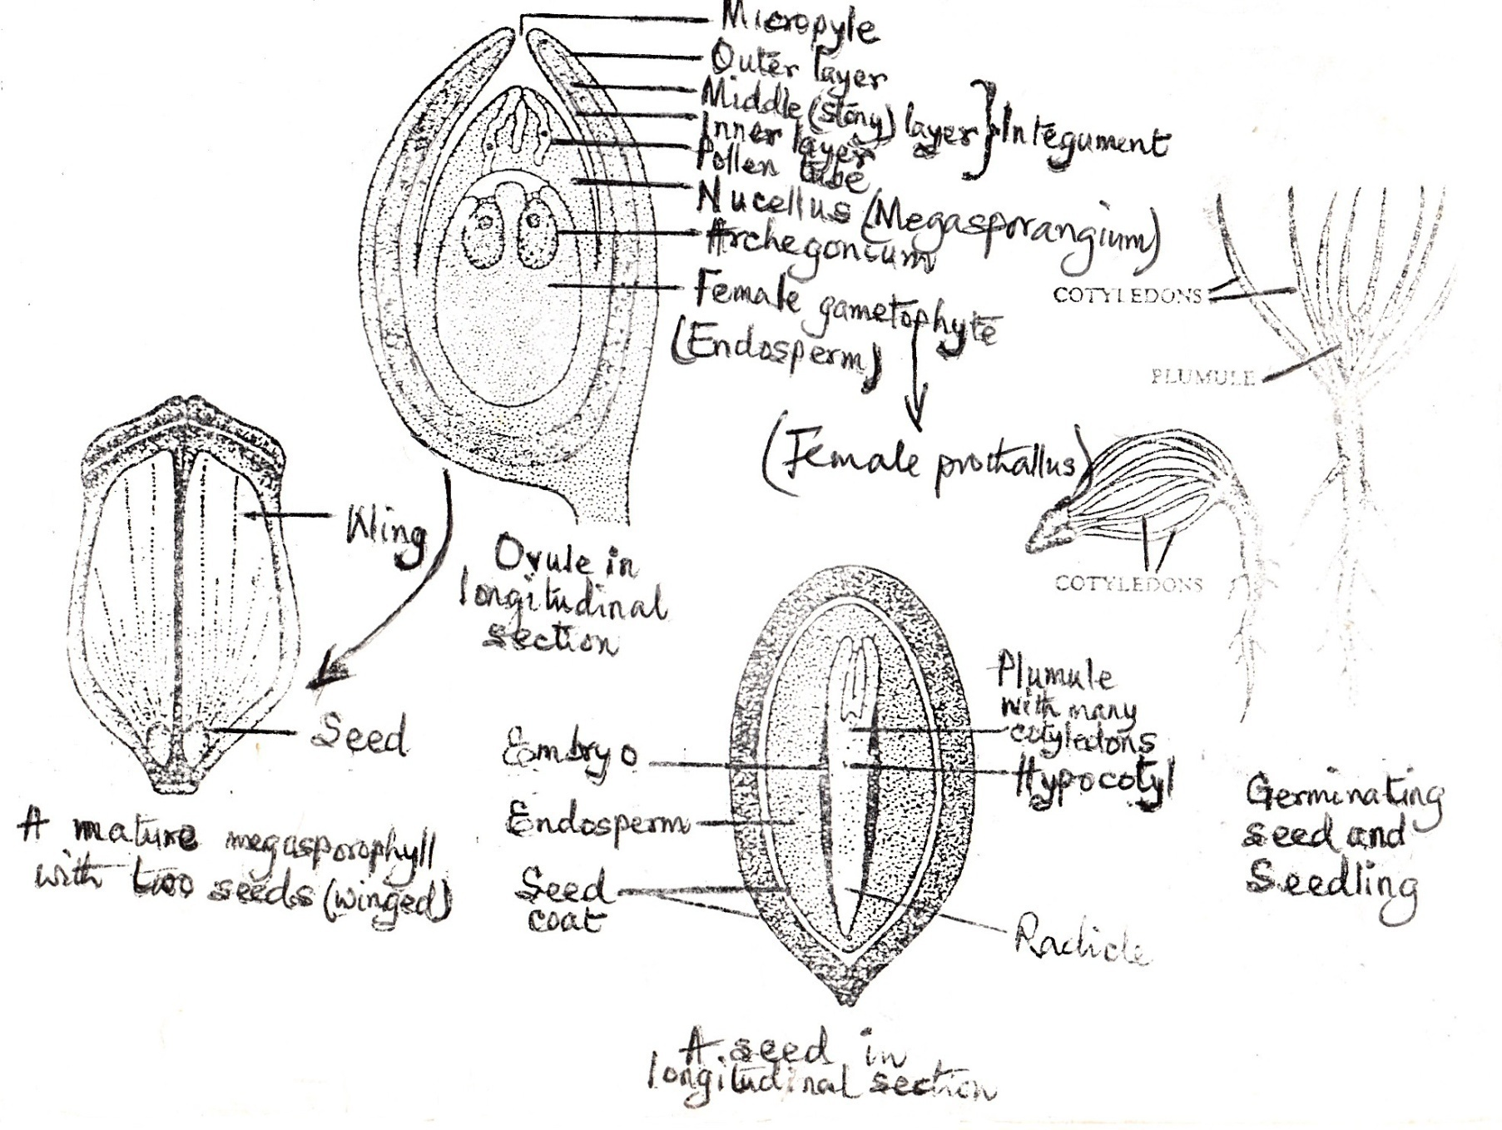

Slide 60
REPRODUCTION
The pine plant is the sporophyte.
It bears two kinds of cones or strobili – male and female – on normally separate branches of the same plant (monoecious).
The male cone consists of microsporophylls or stamens, while the female cone consists of megasporophylls or carpels

Slide 61
Cones always develop on shoots of the current year, a little below their apex.
Several male cones appear in a cluster of spikes, each in the axil of a scale leaf.

Slide 62
REPRODUCTION Cont’d.
The female cones may be solitary or in whorls of 2 to 4, each in the axil of a scale leaf.
The male cones develop much earlier than the female cones.
The flowers have no perianth.

Slide 63
MALE CONE
Several microsporophylls (stamens) are arranged spirally round the axis of the male cone.
Each microphyll is differentiated into a stalk (filament) and a terminal leafy expansion (anther), and its tip is bent upwards.
Its underside bears two pouch-like microsporangia or pollen sacs.

Slide 64
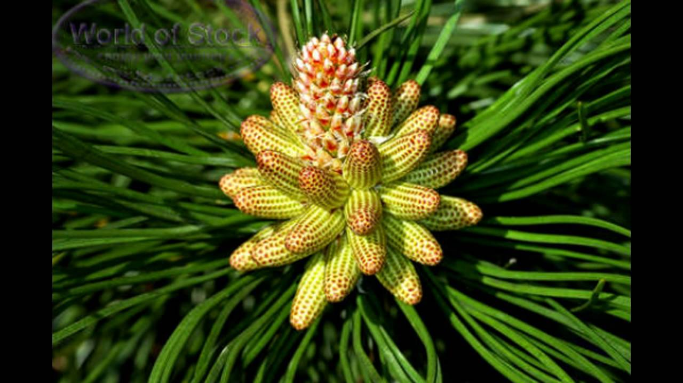

Slide 65
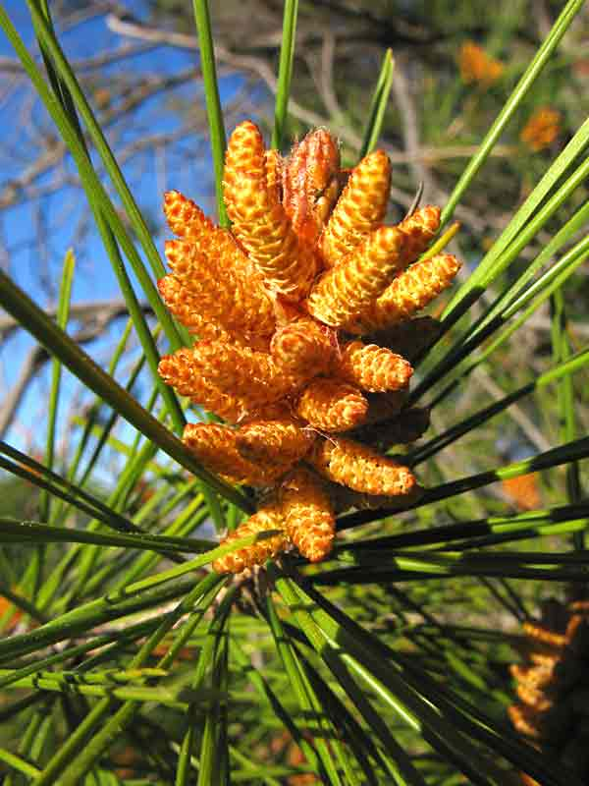

Slide 66
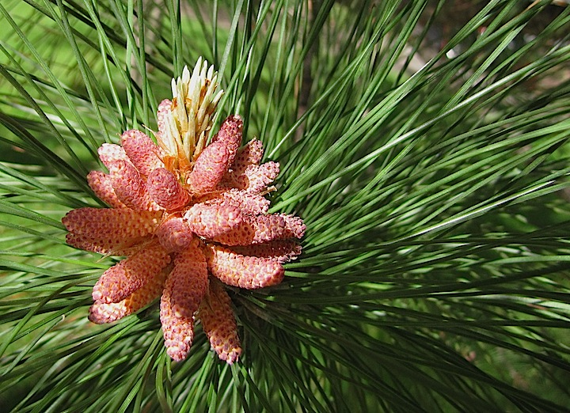

Slide 67
Some conifers may have as many as 15 microsporangia/pollen sacs.
Each pollen sac contains many microspore mother cells, each of which undergoes reduction division to produce a tetrad of microspores or pollen grains.

Slide 68
MALE CONE Cont’d.
Each pollen grain has two coats – exine (outer) and intine (inner).
The exine forms two wings, one on each side.
A huge quantity of pollen is produced for pollination to be brought about by wind.

Slide 69
FEMALE CONE
This consists of an axis with small, thin, dry, brownish scales, spirally arranged around it.
They are known as bract scales or carpellary scales, corresponding to the carpels or megasporophylls.
They are inconspicuous in the mature cone.

Slide 70
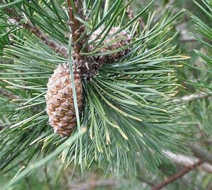

Slide 71
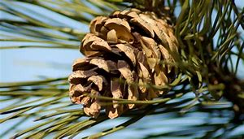

Slide 72
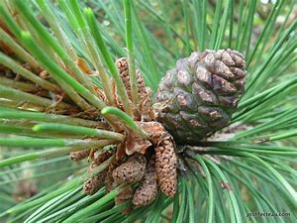

Slide 73
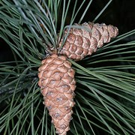

Slide 74
FEMALE CONE Cont’d.
On the upper surface of each bract scale, there is another stouter and bigger scale, woody and somewhat triangular, known as the ovuliferous scale.
This is variously interpreted as an open carpel, a placenta or a ligular outgrowth.

Slide 75
FEMALE CONE Cont’d.
At the base of each ovuliferous scale, lying on its upper surface, are two sessile ovules with their micropyles turned downwards towards the axis of the cone.
Each ovule consists of a central mass of tissue – the nucellus or megasporangium surrounded by a single integument made of three layers.

Slide 76
FEMALE CONE Cont’d.
A megaspore mother cell soon becomes apparent within the nucellus.
It undergoes reduction division to produce four megaspores in a linear tetrad.
Only one megaspore is functional, the other three disintegrate.

Slide 77
MALE GAMETOPHYTE
The microspore or pollen grain begins to divide before it is set free from the microsporangium or pollen sac, and gives rise to the extremely reduced male prothallus (gametophyte) within the microspore coat.

Slide 78
The male prothallus consists of
2 or 3 cells (prothallus cells) at one end, which soon become disorganized
an antheridial cell which is the remaining large cell of the prothallus.

Slide 79
MALE GAMETOPHYTE Cont’d.
The antheridial cell divides and forms a generative cell and a tube cell.
The pollen grain sheds at this stage and subsequent changes take place after pollination.

Slide 80
FEMALE GAMETOPHYTE
The megaspore begins to divide after a period of rest, giving rise to the female prothallus (female gametophyte) within the nucellus.
It digests a big portion of the nucellus and enlarges considerably.

Slide 81
FEMALE GAMETOPHYTE Cont’d.
Soon, it takes to free nuclear division, finally forming a solid mass of tissue – the female gametophyte (otherwise called the endosperm).
It is completely endosporous ie. it remains permanently enclosed within the nucellus.

Slide 82
It is completely endosporous ie. it remains permanently enclosed within the nucellus.
The endosperm grows quickly after fertilization, invades the nucellus and surrounds the embryo in the seed.
At the micropylar end of the prothallus, lying embedded in it, develop 2 to 5 archegonia.

Slide 83
FEMALE GAMETOPHYTE Cont’d.
These are very small.
Each archegonium consists of a swollen venter and a short neck.
The venter encloses a large egg-cell (almost filling the cavity) with a distinct egg-nucleus in it.
The archegonia mature slowly and become ready for fertilization only in the following year.

Slide 84
POLLINATION
Pollination takes place through the agency of the wind.
Soon after the female cone emerges from the bud, the pollen sacs burst and the winged pollen grains are blown about by the wind like a yellow cloud of dust.
Some of them happen to fall on the young female cone.
A huge quantity is wasted, however.

Slide 85
POLLINATION Cont’d.
The pollen grains pass between the two slightly opened scales and are deposited at their base.
A quantity of mucilage is secreted at the micropyle, in which the microspores get entangled.
After pollination, the scales close up and so does the wide, gaping micropyle.

Slide 86
POLLINATION Cont’d.
The mucilage is drawn in by the nucellus together with the microspores
The microspores then lodge somewhere at the apex of the nucellus for about a year.

Slide 87
Fertilization takes place in the following year at about the same time; the cone develops fully when the archegonia mature, in the third year.

Slide 88
FERTILIZATION
The outer coat (exine) of the pollen grain bursts and the inner coat (intine) grows out into a slender tube, ie. the pollen tube.
This pushes forward through the nucellus and finally reaches the neck of the archegonium.

Slide 89
The pollen tube is characteristic of all gymnosperms and angiosperms.
The pollen tube nucleus passes into the pollen tube.

Slide 90
FERTILIZATION Cont’d.
The generative cell divides and forms a stalk cell and a body cell.
Both of these cells migrate into the pollen tube.
The stalk cell is sterile while the body cell divides and produces two male gametes.

Slide 91
FERTILIZATION Cont’d.
The male gametes are not ciliate as in cycads.
The pollen tube bursts at the apex and the two male gametes are liberated.

Slide 92
The nucleus of the functioning male gamete slips out of the cytoplasm and passes on to the egg-nucleus.
The other male gamete, the stalk cell and the tube nucleus become disorganized.

Slide 93
SEED
After fertilization the ovules develop into seeds and the whole female flower turns into a dry, brown, woody cone.
The seed is albuminous in all gymnosperms.
The seed coat is provided with a membranous wing which is formed from the ovuliferous scale.

Slide 94
The seed coat (integument) has three layers – the inner and outer being thin, and the middle stony.
The fully developed embryo of the seed consists of an axis with a hypocotyl, radicle and a tiny plumule with many cotyledons surrounding it.

Slide 95
SEED Cont’d.
The cotyledons are pushed upwards during germination.
The cotyledons turn green; germination is epigeal.
The radicle grows downwards into a distinct tap root.

Slide 96
SUBDIVISION ANGIOSPERMA The Angiosperms
The second great group of seed-producing plants, the angiosperms - commonly known as flowering plants – is both the largest group in number of genera, species and individuals and the most recent to develop on the earth (its origins being the Cretaceous).

Slide 97
ANGIOSPERMS Cont’d.
The structure of the seeds may have come about by the evolutionary folding of a leaf-like, ovule-bearing megasporophyll.
The angiosperms exceed all other vascular plants in range of diversity of the plant body and habitat, and in their utility to mankind.

Slide 98
ANGIOSPERMS Cont’d.
After the angiosperm seed geminates, an extensive period of somatic or vegetative development of the sporophyte follows.
This may be terminated by flowering as in annuals (for example, maize) or it may continue during and after flowering, as in perennials.

Slide 99
GROSS MORPHOLOGY OF FLOWERS Cont’d
The flower is the reproductive structure of the angiosperms,
but it is a difficult structure to define in precise enough terms to distinguish it from aggregations of microsporophylls and megasporophylls,
which we have called strobilli or cones in gymnosperms and vascular cryptogams.

Slide 100
GROSS MORPHOLOGY OF FLOWERS Cont’d
Flowers, like strobili, are stems in which the apical meristems have differentiated completely, so that the meristem is ‘used up’.
In flowers, as in strobili, the axis, or receptacle that bears the sporophylls (stamens and pistils) has short internodes, so that the sporophylls are borne either in a tight spiral or in a seemingly whorled and cyclic arrangement.

Slide 101
MORPHOLOGY Cont’d.
In the case where they are in whorled and cyclic arrangement, three, four, or five sporophylls usually arise at a given level of the axis.
In addition to the sporophylls, floral axes usually bear sterile appendages called Sepals(collectively, the Calyx), which are generally green (but sometimes other colours), and Petals (collectively, the Corolla).

Slide 102


Slide 103
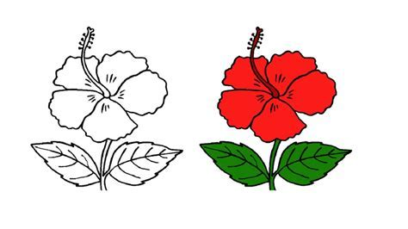

Slide 104
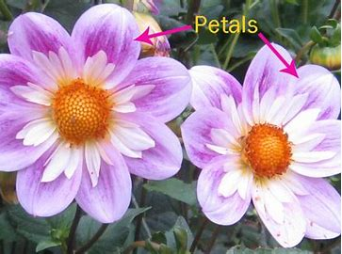

Slide 105
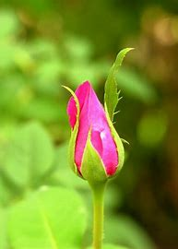

Slide 106
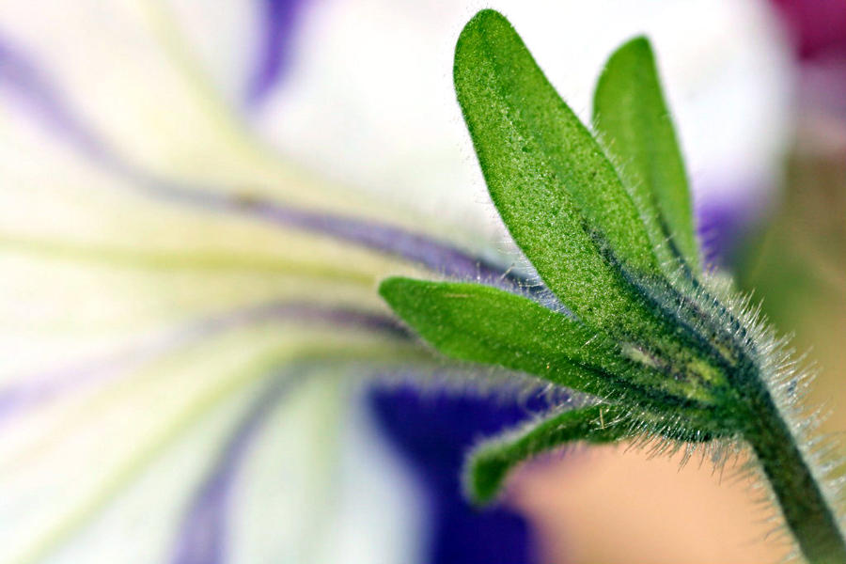

Slide 107
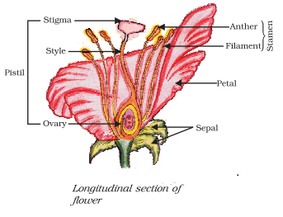

Slide 108
MORPHOLOGY Cont’d.
When petals and sepals are not clearly different from each other, they are called Tepals.
The sepals and the petals together comprise the Perianth.
The Essential parts of the flower are the sporophylls.

Slide 109
MORPHOLOGY Cont’d.
In angiosperms, the microsporophylls are known as Stamens and the megasporophylls or fused groups of them are known as Pistils.
Stamens produce microspores (pollen grains) and pistils produce megaspores (within their ovules).

Slide 110
MORPHOLOGY Cont’d.
Stamens and pistils of angiosperms probably correspond especially in function to the microsporophylls and megasporophylls, respectively, of both gymnosperms and certain seedless vascular plants.

Slide 111
Pistils usually consist of an enlarged basal portion, the Ovary, which contains one or more ovules and a receptive surface for pollen, the Stigma.

Slide 112
MORPHOLOGY Cont’d.
The stigma and ovary are connected by a more or less elongated Style.
Pistils may be either simple or compound.
A Simple pistil is composed of one-ovule bearing megasporophyll or Carpel; the carpel therefore is the equivalent of the megasporophyll.

Slide 113
MORPHOLOGY Cont’d.
Compound pistils are composed of several simple pistils (or carpels or megasporophylls) that have become united during evolution;
in some flowers they unite in development.

Slide 114
Simple pistils have only one cavity containing ovules,
whereas compound pistils have ovaries partitioned into two or more chambers.

Slide 115
MORPHOLOGY Cont’d.
In the vast majority of angiosperms both stamens and pistils occur on the same individual sporophyte and are usually borne together in single flowers; such flowers are said to be Perfect.

Slide 116
In some species, however, Staminate flowers bear microsporophylls (stamens) alone on their receptacles (axis), while Pistillate flowers have only megasporophylls (pistils) on their receptacles (axis).

Slide 117
MORPHOLOGY Cont’d.
Such staminate and pistillate flowers are said to be Imperfect.
Maize and oil palm are examples of monoecious plants with imperfect flowers, since both types of flowers (staminate and pistillate) are borne on the same individuals.

Slide 118
MORPHOLOGY Cont’d.
In other angiosperms, the staminate and pistillate flowers occur on different individuals, as in the pawpaw, willow, poplar and mulberry, among others; such plants are accordingly, dioecious.

Slide 119
Flowers may be large, conspicuous and borne singly,
or they may arise on the same axis in various types of inflorescences in which the individual flowers may sometimes be smaller and less striking.

Slide 120
MORPHOLOGY Cont’d.
Of the various types of inflorescences, the head or Capitulum, is especially frequent and characterizes the large family Asteraceae.
In one type, two types of flowers are present, the minute bell-like central Disc florets and the larger, peripheral Ray florets.

Slide 121
MORPHOLOGY Cont’d.
The disc florets are perfect and complete with stamens, a pistil, a calyx and a corolla.
In the ray florets, the corolla is split open near the base and stamens are absent.

Slide 122
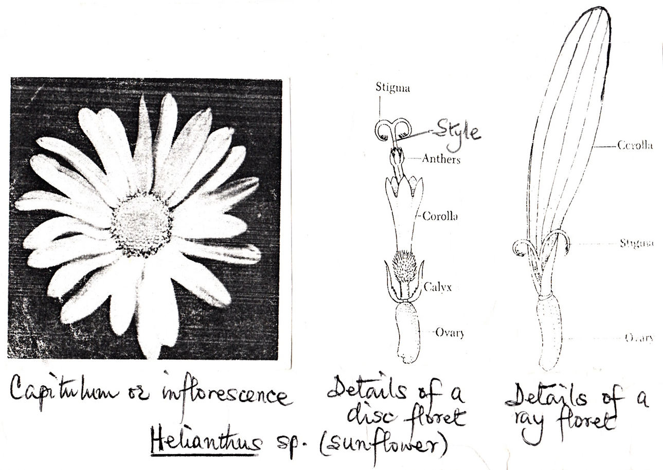

Slide 123
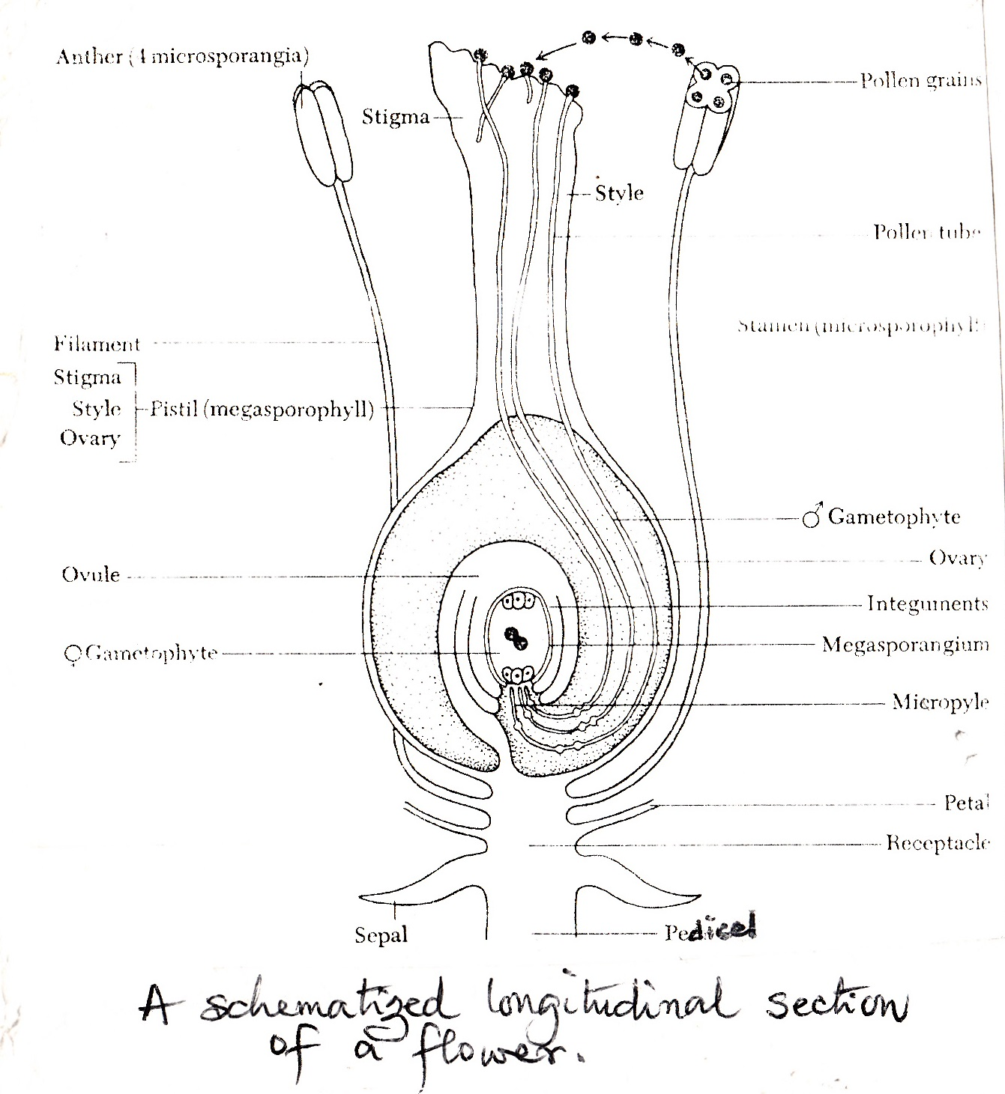

Slide 124
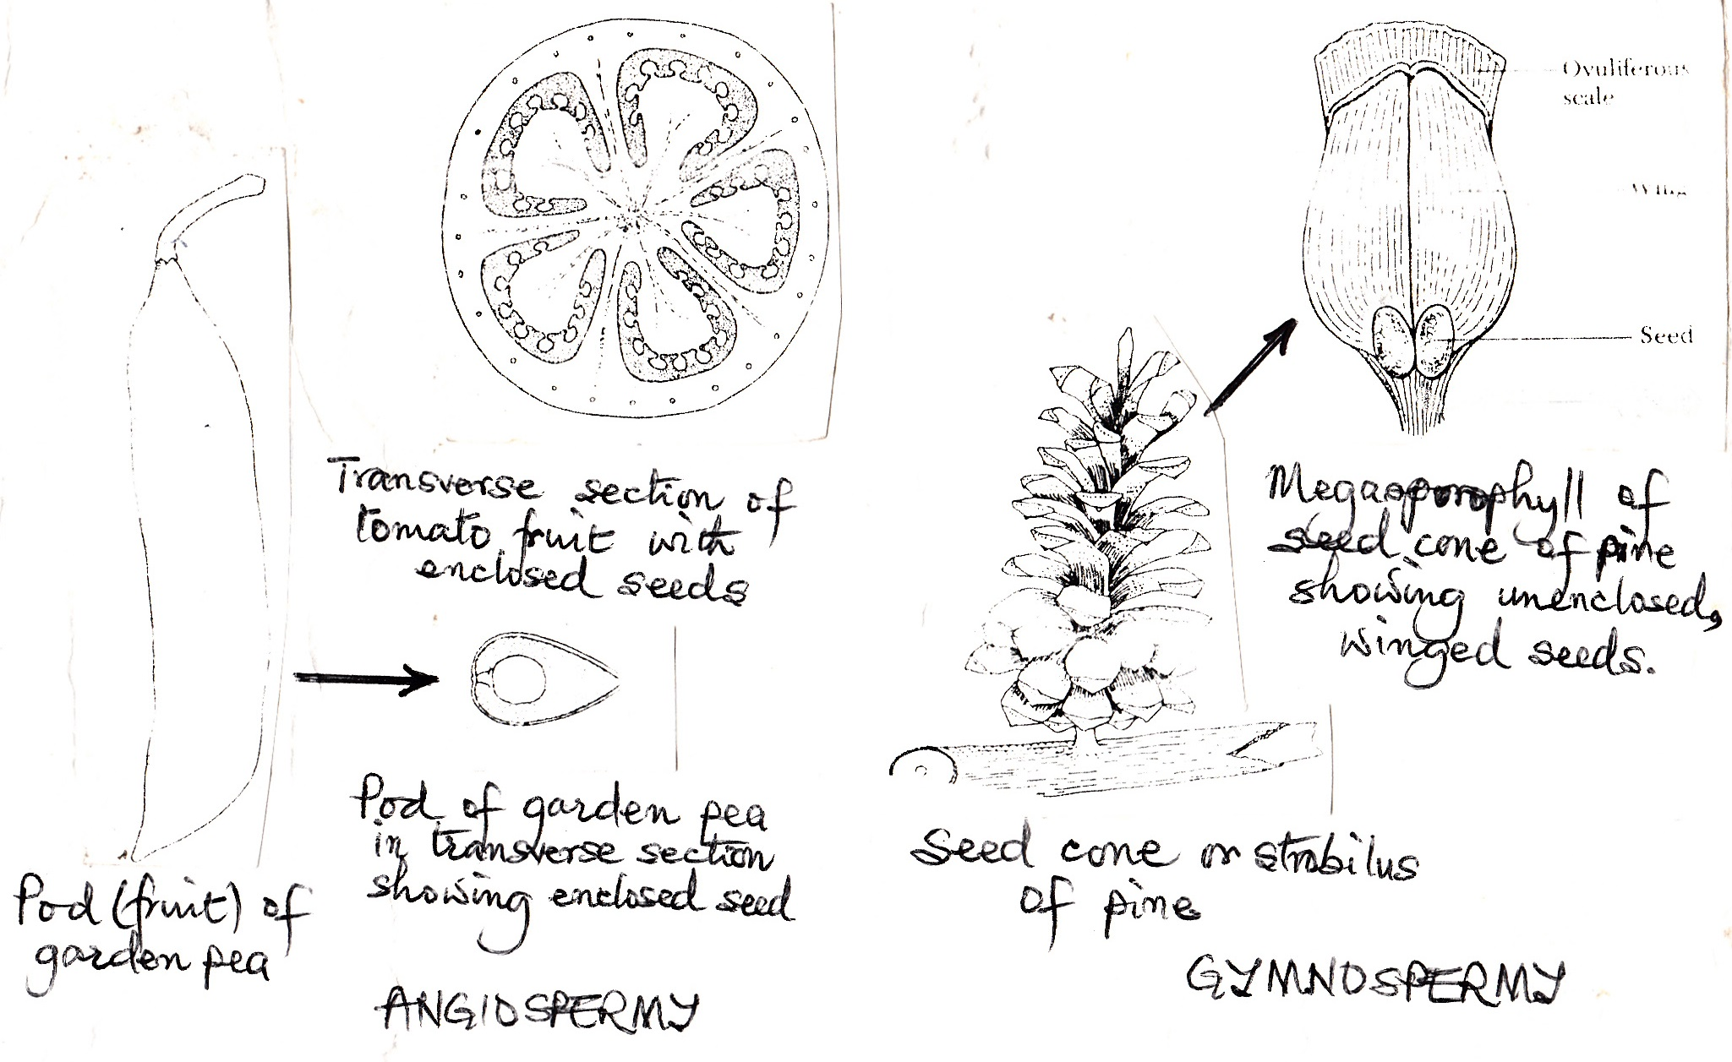

Slide 125
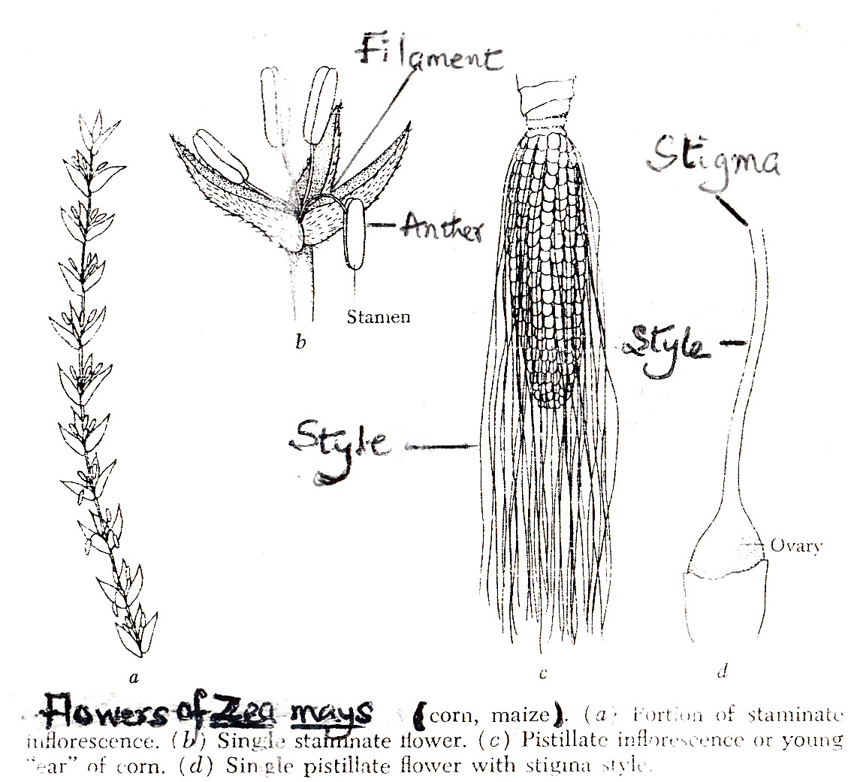

Slide 126
THE REPRODUCTIVE PROCESS
The angiosperm flower bears a carpel or megasprophyll and a stamen or microsporophyll.
The carpel bears a nucellus or megasporangium within the ovule which develops within the ovary and the stamen bears the pollen sacs or microsporangia ie. the anthers.

Slide 127
REPRODUCTIVE PROCESS Cont’d.
The megasporangium (nucellus) in its turn produces the megaspore mother cell.
When the flower is still in the bud the diploid megaspore mother cell differentiates from all the other cells in the ovule.
This undergoes meiosis, producing four haploid megaspores.

Slide 128
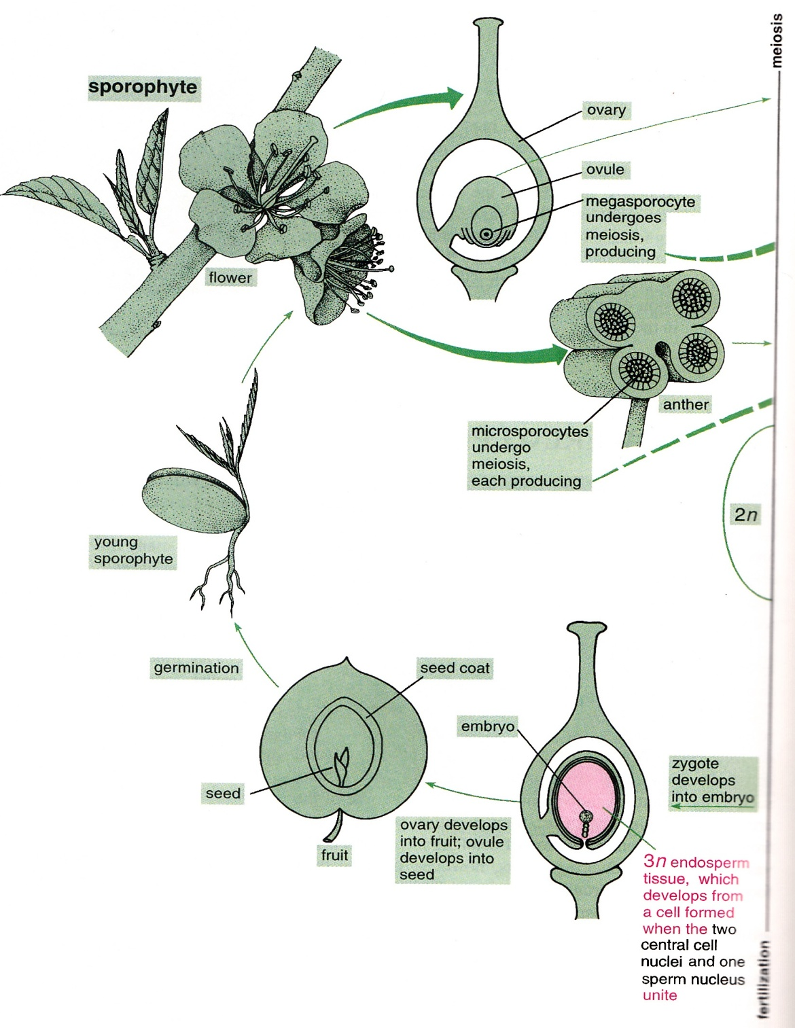
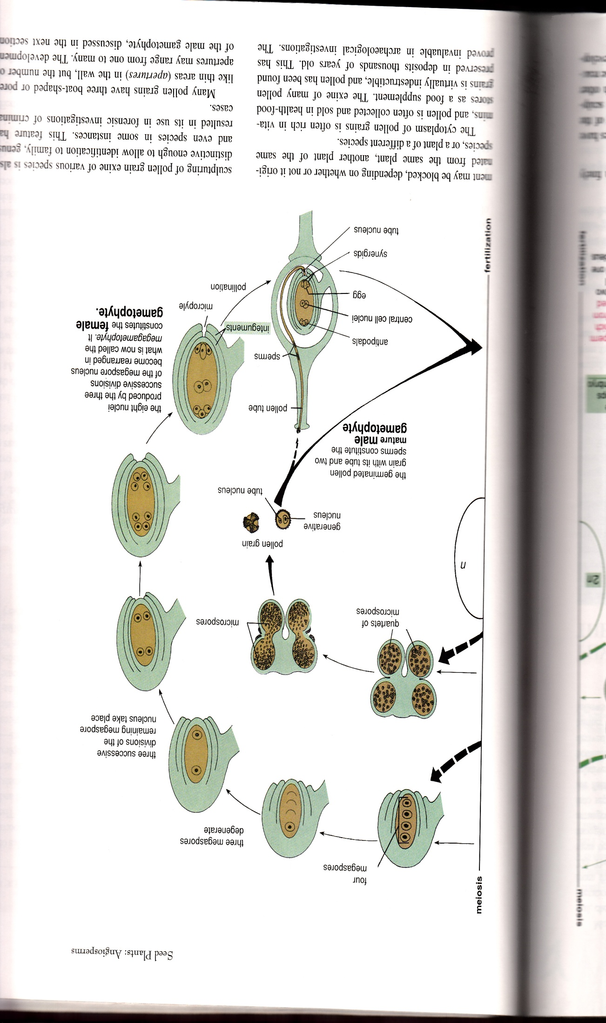
LIFE CYCLE OF A TYPICAL FLOWERING PLANT

Slide 129
REPRODUCTIVE PROCESS Cont’d.
Soon after they are produced, three of these megaspores degenerate and disappear but the nucleus of the fourth undergoes mitosis and the cell enlarges.
While the cell is growing larger, its two haploid nuclei divide once more.

Slide 130
REPRODUCTIVE PROCESS Cont’d.
The resulting four nuclei then divide again.
Consequently eight haploid nuclei in all are produced (without walls being formed between them).
At the same time, two outer layers of cells of the ovule differentiate.
These layers, called integuments, later become the seed coat of the seed.

Slide 131
REPRODUCTIVE PROCESS Cont’d
As they develop they leave a pore or gap called the micropyle at one end.
At this stage there are eight haploid nuclei in two groups, four nuclei towards each end of the large cell.
One nucleus from each group then migrates towards the middle of the cell.

Slide 132
REPRODUCTIVE PROCESS Cont’d
These two polar nuclei may become a binucleate cell or they may fuse together forming a single diploid nucleus.
Cell walls also form around the remaining nuclei.
In the group closest to the micropyle, one of these cells functions as the female gamete or egg.

Slide 133
REPRODUCTIVE PROCESS Cont’d.
The other two cells, called Synergids, either are destroyed or degenerate during or after events that occur later.
At the other end, the remaining three cells, called Antipodals, have no apparent function and later they also degenerate.

Slide 134
The large sac, usually containing eight nuclei in seven cells, constitutes the Female gametophyte.
At maturity, it is called an Embryo sac.

Slide 135
REPRODUCTIVE PROCESS Cont’d.
While the female gametophyte is developing, a parallel process that leads to the formation of male gametophytes takes place in the anthers.
As an anther develops, four patches of tissue differentiate from the main mass of cells.

Slide 136
REPRODUCTIVE PROCESS Cont’d.
These patches of tissue contain many diploid Microspore Mother cells, each of which undergoes meiosis, producing a quartet (or tetrad) of Microspores.
Four chambers or cavities (pollen sac) are visible in the cross section of an anther by the time the microspores have been produced.

Slide 137
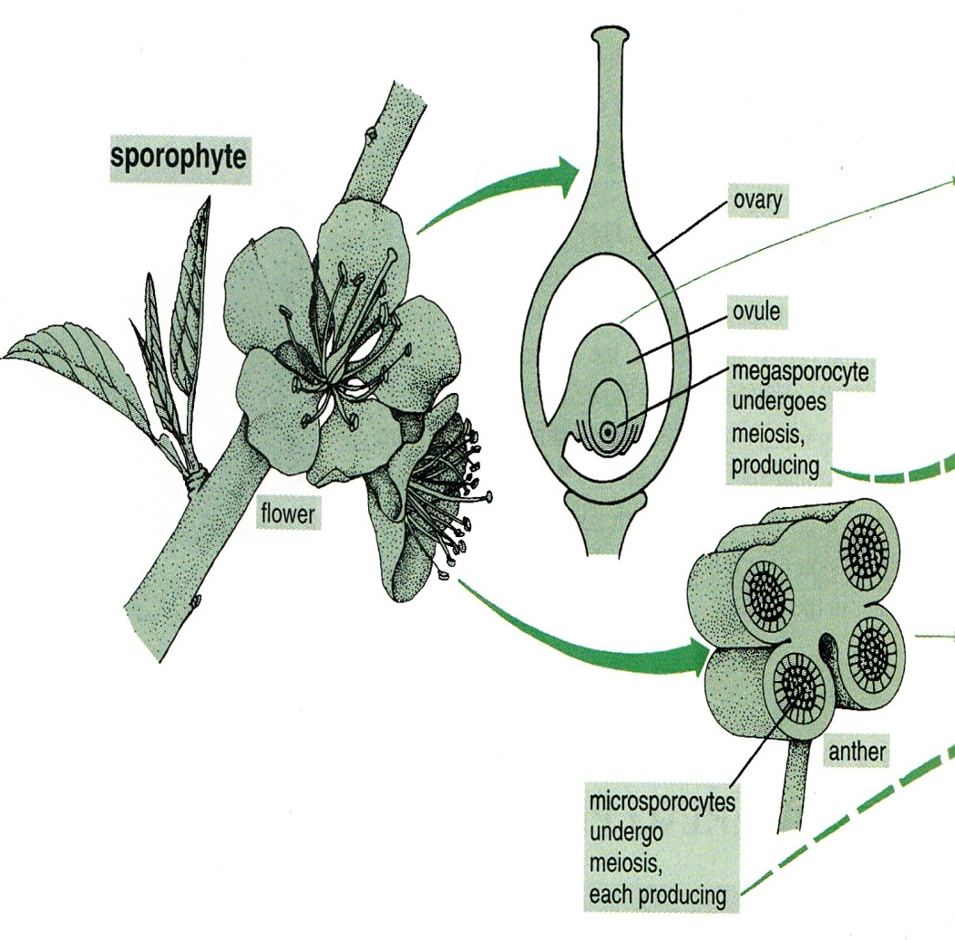
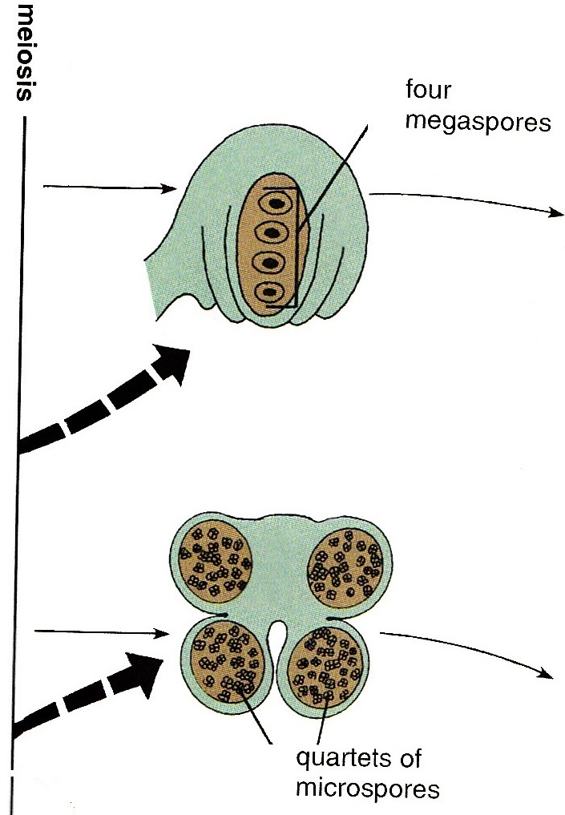

Slide 138
REPRODUCTIVE PROCESS Cont’d.
As the anther matures, the walls between adjacent chambers break down so that only two larger sacs remain.
After meiosis, the microspores in the pollen sacs undergo several changes more or less simultaneously:

Slide 139
REPRODUCTIVE PROCESS Cont’d.
the nucleus in each microspore divides once (mitotic), forming the generative nucleus and the tube nucleus.
members of each quartet of microspores separate from one another, and
a two-layered wall develops around each microspore.

Slide 140
REPRODUCTIVE PROCESS Cont’d.
When these events are complete, the microspores have become Pollen grains
The outer layer of the pollen grain wall, called the Exine, contains chemicals that may later react with other chemicals in the stigma of the flower.

Slide 141
REPRODUCTIVE PROCESS Cont’d.
One of the pollen grain’s two nuclei, the Generative nucleus, will later divide, producing two male gametes (sperms).
The remaining tube nucleus is involved in events that take place after the pollen grain has left the anther.

Slide 142
LIFE CYCLE OF A TYPICAL FLOWERING PLANT

Slide 144
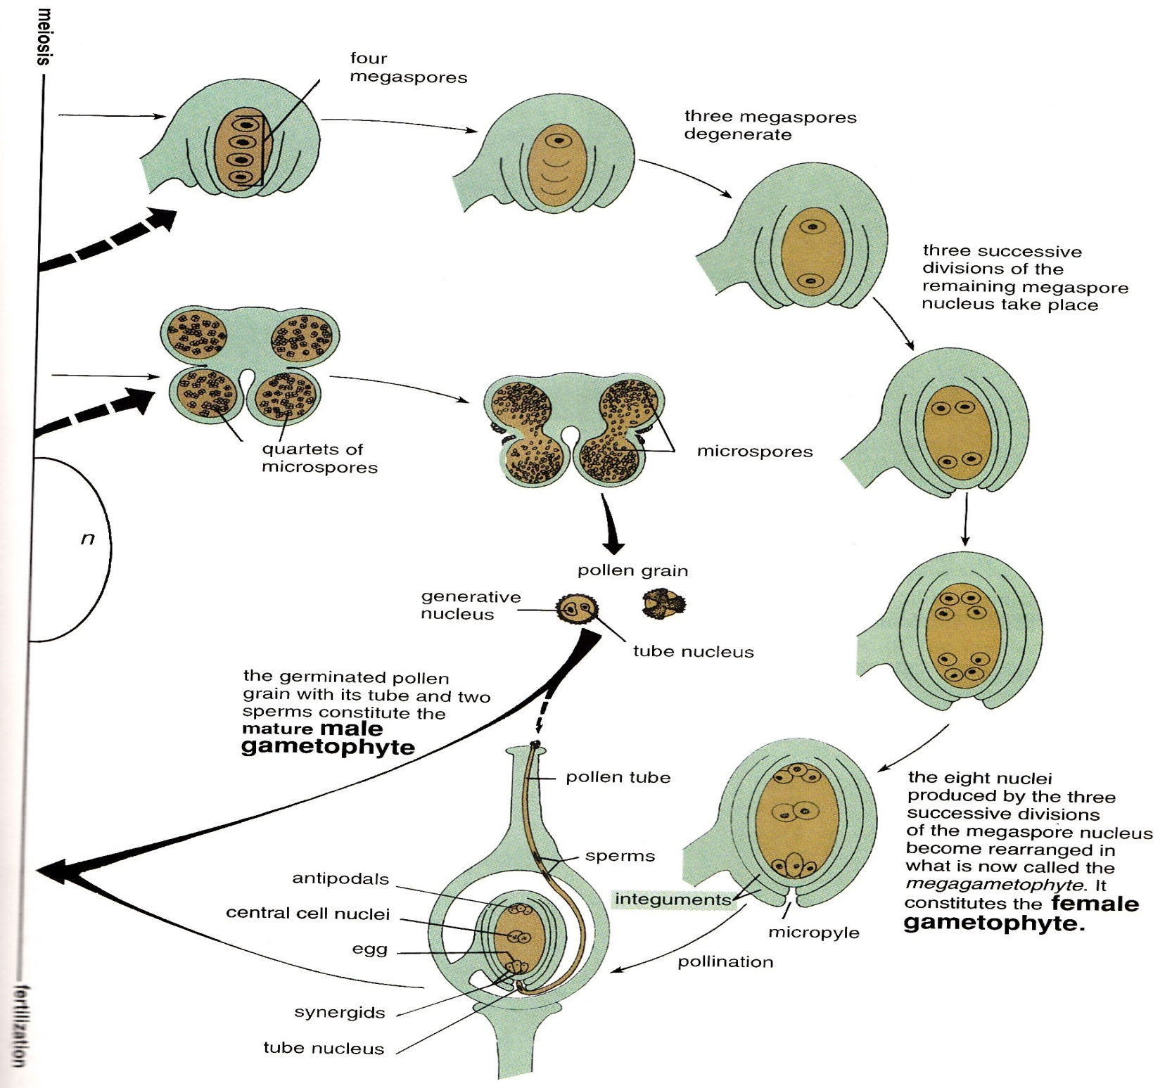
Integuments
Male gamete

Slide 145
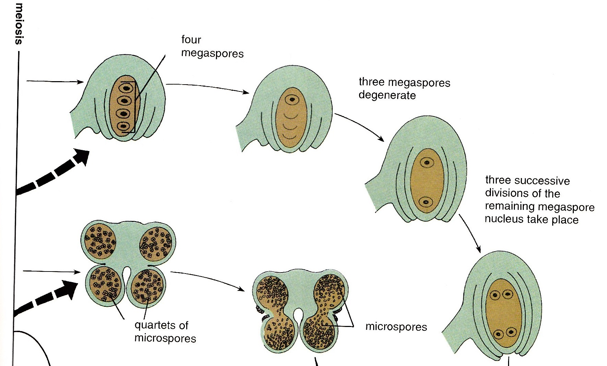

Slide 146
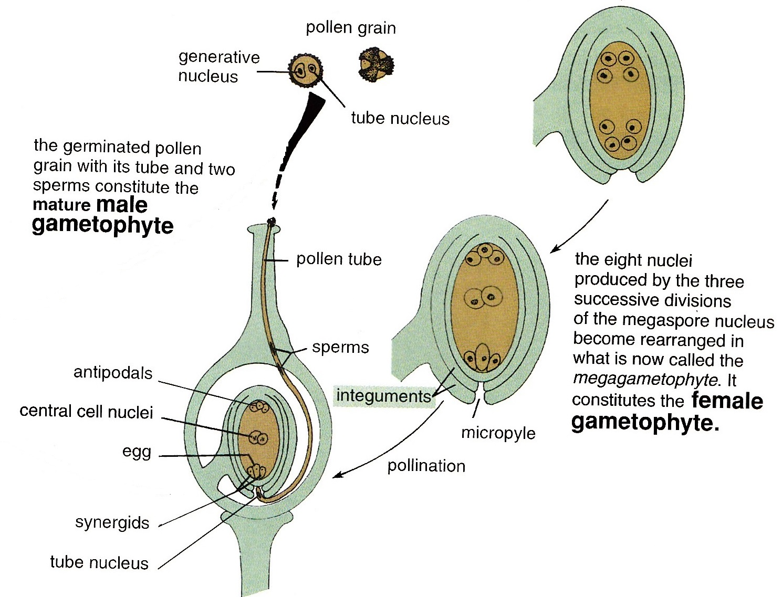

Slide 147
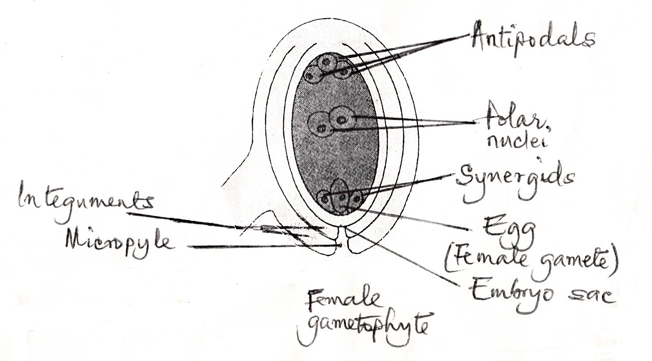

Slide 148
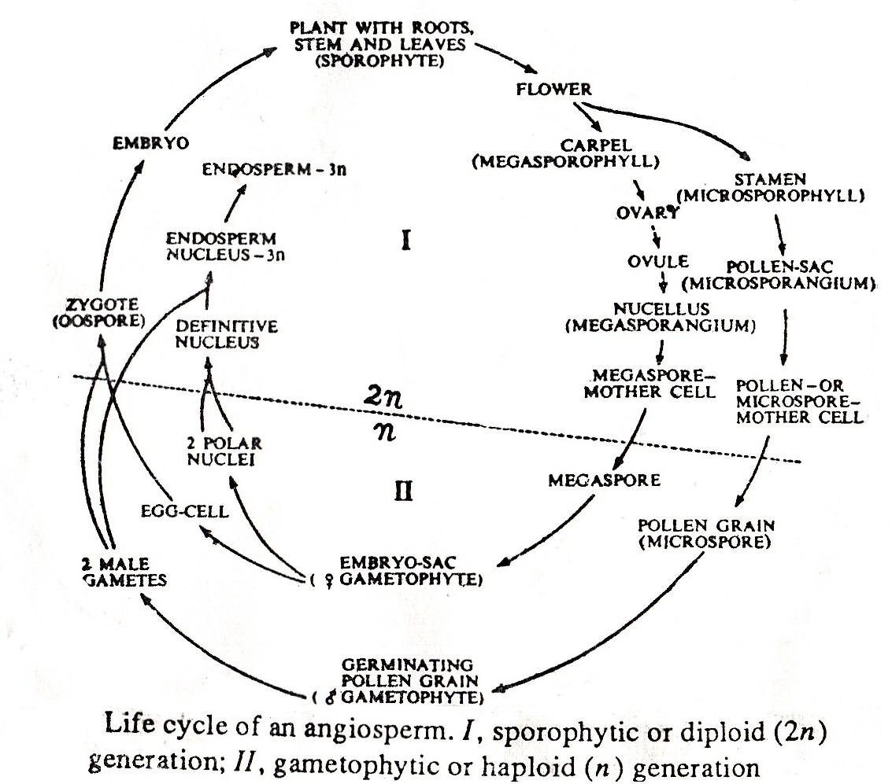

Slide 149
POLLINATION AND FERTILIZATION
Pollination is the transfer of pollen from an anther to a stigma.
Fertilization is the formation of a zygote through the fusion of two gametes.
Fertilization may not occur until days or weeks or months after pollination has taken place, or it may not follow pollination at all.

Slide 150
POLLINATION AND FERTILIZATION Cont’d.
After pollination, the pollen grain germinates on the stigma of the carpel (pistil)
and forms the Pollen tube which grows down between the cells of the stigma and style until it reaches the micropyle.

Slide 151
POLLINATION AND FERTILIZATION Cont’d.
As the pollen tube grows most of the contents of the pollen grain are discharged into it.
The tube nucleus stays at the tip, while the generative nucleus (cell) lags behind and divides by mitosis usually in the tube, producing two male gametes without cilia.

Slide 152
The germinated pollen grain with its tube nucleus and two male gametes constitutes the mature male gametophyte.

Slide 153
POLLINATION AND FERTILIZATION Cont’d.
When the pollen tube reaches the micropyle, it continues on to the embryo sac, enters it, destroying a synergid in the process;
it then bursts, discharging its contents.
Next an event unique to angiosperms, called Double fertilisation (or Double fusion) takes place.

Slide 154
POLLINATION AND FERTILIZATION Cont’d.
One male gamete migrates from the synergid to the egg, and its nucleus unites with the egg nucleus forming a Zygote.
The other male gamete also migrates from the synergid towards the polar nuclei and upon arrival, unites with the polar nuclei producing a 3n (triploid) Endosperm nucleus.

Slide 155
POLLINATION AND FERTILIZATION Cont’d.
The endosperm nucleus divides repeatedly by mitosis, usually without formation of cell walls.
The nutritive 3n tissue, called Endosperm, may eventually have hundreds of nuclei; it surrounds the Embryo that develops from the zygote.

Slide 156
POLLINATION AND FERTILIZATION Cont’d.
In some monocots, such as maize and other grasses, the endosperm tissue becomes an extensive part of the seed,
but in most dicots, such as members of the Legume family (eg. peas, beans), the endosperm provides nourishment for the embryo that develops from the zygote but disappears by the time the seed is mature.

Slide 157
POLLINATION AND FERTILIZATION Cont’d.
The integuments harden, becoming a Seed coat, and the remaining haploid nuclei, or cells (antipodals, synergids and tube nucleus), degenerate.
At the end, the ovule has become a seed and the ovary matures into a fruit.

Slide 158
DIFFERENCES BETWEEN GYMNOSPERMS AND ANGIOSPERMS
In angiosperms, the xylem is composed mainly of vessels, and the phloem contains companion cells, while in gymnosperms the xylem is made exclusively of tracheids, and the phloem contains no companion cells.

Slide 159
DIFFERENCES BETWEEN GYMNOSPERMS AND ANGIOSPERMS Cont’d
In higher gymnosperms, as in Gnetum, however, there is a combination of gymnospermic tracheids and angiospermic vessels.
Flowers are much simpler in gymnosperms than in the angiosperms.

Slide 160
DIFFERENCES BETWEEN GYMNOSPERMS AND ANGIOSPERMS Cont’d
Gymnosperms have no calyx or corolla and are always unisexual, consisting of either microsporophylls (stamens) or megaporophylls (carpels) only.
The plants are either monoecious or dioecious.

Slide 161
DIFFERENCES Cont’d.
The stamens and carpels are much simpler than in angiosperms.
The sporophylls are borne in strobilli (except the megasporophylls of cycads), whereas in angiosperms they are borne on flowers.

Slide 162
DIFFERENCES Cont’d.
The only agency of pollination in gymnosperms is air current, while there are many pollinating agents in the case of angiosperms.
In gymnosperms the ovules are borne freely exposed on the megasporophyll (carpel) while in angiosperms, the ovules remain enclosed in the ovary, the carpel itself being differentiated into ovary, style and stigma.

Slide 163
DIFFERENCES Cont’d.
For pollination in gymnosperms, pollen grains enter the micropyle and are deposited on the nucellus, whereas in angiosperms they are deposited on the stigma.

Slide 164
DIFFERENCES Cont’d.
In angiosperms and higher gymnosperms, the male gametes contained in the pollen tube are two massive units, but in lower gymnosperms (Cycas, Zamia and Ginkgo), the male gametes are in the nature of ciliate spermatozoids.

Slide 165
DIFFERENCES Cont’d.
In gymnosperms, the male gametophyte is represented by a few cells (usually 2 or 3) – a vestigial prothallus.
In angiosperms, it is reduced to two nuclei – the tube nucleus and the generative nucleus. (There is very little evidence of a male prothallus in angiosperms)

Slide 166
DIFFERENCES Cont’d.
The female gametyphyte in gymnosperms is a relatively large structure with distinct archegonia embedded in it, each with an ovum.
In angiosperms, however, the female gametophyte is a vestigial prothallus represented by an 8-nucleate embryo sac, and the ovum or egg-cell is free in it without any archegonium.

Slide 167
DIFFERENCES Cont’d.
The endosperm, where present in the angiosperms, is formed from the definitive nucleus only after fertilization and is triploid in nature.
In gymnosperms, the endosperm is formed from the definitive tissue of the female prothallus before fertilization (completed, however, after fertilization) and is diploid in nature.

Slide 168
DIFFERENCES Cont’d.
There are 2 to 15 cotyledons in gymnosperms, and 1 or 2 in angiosperms.
The seeds in all gymnosperms are endospermic.

Slide 169
DEVELOPMENT OF THE SEED IN GYMNOSPERMS
The seed makes its appearance for the first time in gymnosperms.
It develops from the ovules and the following factors are responsible for its development:
Heterospory and differentiation of sporophylls and sporangia are the initial factors, as found in Selaginella, leading towards seed production.

Slide 170
DEVELOPMENT OF THE SEED Cont’d.
Enclosures of the megasporangium and the female gametophyte within a new structure ie. the integument – the whole complex body so formed being known as the ovule.
After fertilization and maturity, the ovule gives rise to the seed.

Slide 171
DEVELOPMENT OF THE SEED Cont’d.
Attachment of the megasporangium (and the ovule) to the megasporophyll till after its development into the seed.
Development of the young sporophyte (embryo) within the tissue of the megasporangium (nucellus), which belongs to the mother sporophyte, ensuring better feeding and greater protection.

Slide 172
DEVELOPMENT OF THE SEED Cont’d.
Development of the pollen tube for facilitation of fertilization under the new condition of ovule formation.
It is thus evident that the seed of the angiosperm is a complex structure with three generations locked up in it:

Slide 173
DEVELOPMENT OF THE SEED Cont’d.
the seed-coat or testa representing the parent sporophyte (old generation)
the female gametophyte representing the present generation, and
the embryo representing the new sporophyte (future generation).

Slide 174
DEVELOPMENT OF THE SEED Cont’d.
The retention of the megaspore within the megasporangium (nucellus of the ovule) and its germination into the female gametophyte (embryo sac) within the megasporangium, so that the female gametophyte becomes completely endosporous.
The female gametophyte is partially endosporous in Selaginella.

Slide 175
SIGNIFICANCE (FUNCTIONS) OF THE SEED
Serves for reproduction.
Receptacle or vessel in which the embryo develops.
Encloses the embryo and protects it from adverse environmental conditions (excessive heat, cold, rain, etc.) and attack by insects and rodents.

Slide 176
SIGNIFICANCE (FUNCTIONS) Cont’d
Stores up food for the embryo or the seedling.
May be modified to facilitate dispersal from the parent gametophyte (plant).

Slide 177
SIGNIFICANCE OF THE SEED Cont’d.
Seeds are important source of food for animals and man.
(Members of the family Poaceae provide more food seeds than any other plant family; this is followed by the Fabaceae).

Slide 178
SIGNIFICANCE Cont’d
Seeds have many other uses besides serving as food:
-Source of beverages (coffee, cacao, beer)
-Medicines
-Fibre (cotton)
-Industrial oils

Slide 179
SOME DIFFERENCES BETWEEN MONOCOTS AND DICOTS
Monocots | Dicots
1. Seed with one cotyledon (seed leaf) | 1. Seed with two cotyledons (seed leaves)
2. Leaves with more or less parallel venation | 2. Leaves with a network of veins
3. Groups of vascular tissues scattered | 3. Groups of vascular tissues in a ring

Slide 180
DIFFERENCES BETWEEN MONOCOTS AND DICOTS Cont’d
Monocots | Dicots
4. Pollen grains mostly with one aperture | 4. Pollen grains mostly with three or more apertures
5. Flower parts mostly in threes or multiples of three | 5. Flower parts in fours or fives or multiples of four or five

Slide 181
Dicots are the more primitive of the two classes with the monocots apparently having derived from early dicots, possibly before the middle of the Cretaceous period.

Slide 182
PALYNOLOGY
Palynology is the study of spores and pollen grains.
The spores and pollen grains of individual plants can be identified and assigned with great accuracy to their species;
this in part, is the division of botany known as Palynology.

Slide 183
PALYNOLOGY Cont’d
Identification of pollen grains is important in the diagnosis and treatment of such allergies as hay fever, rose fever, and so forth.

Slide 184
PALYNOLOGY Cont’d
Furthermore, through the examination of peat and other deposits containing spores and pollen grains, it has been possible to ascertain the composition of ancient floras and to determine past changes of climate in locations where such deposits occur.

